Slide 1
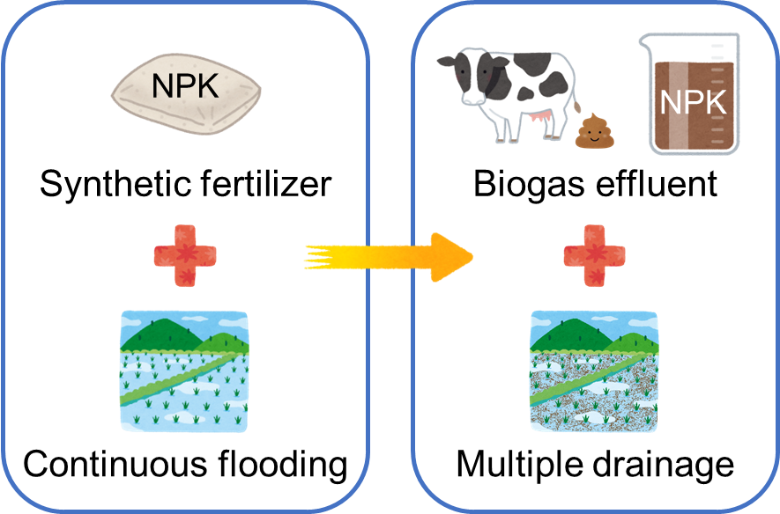
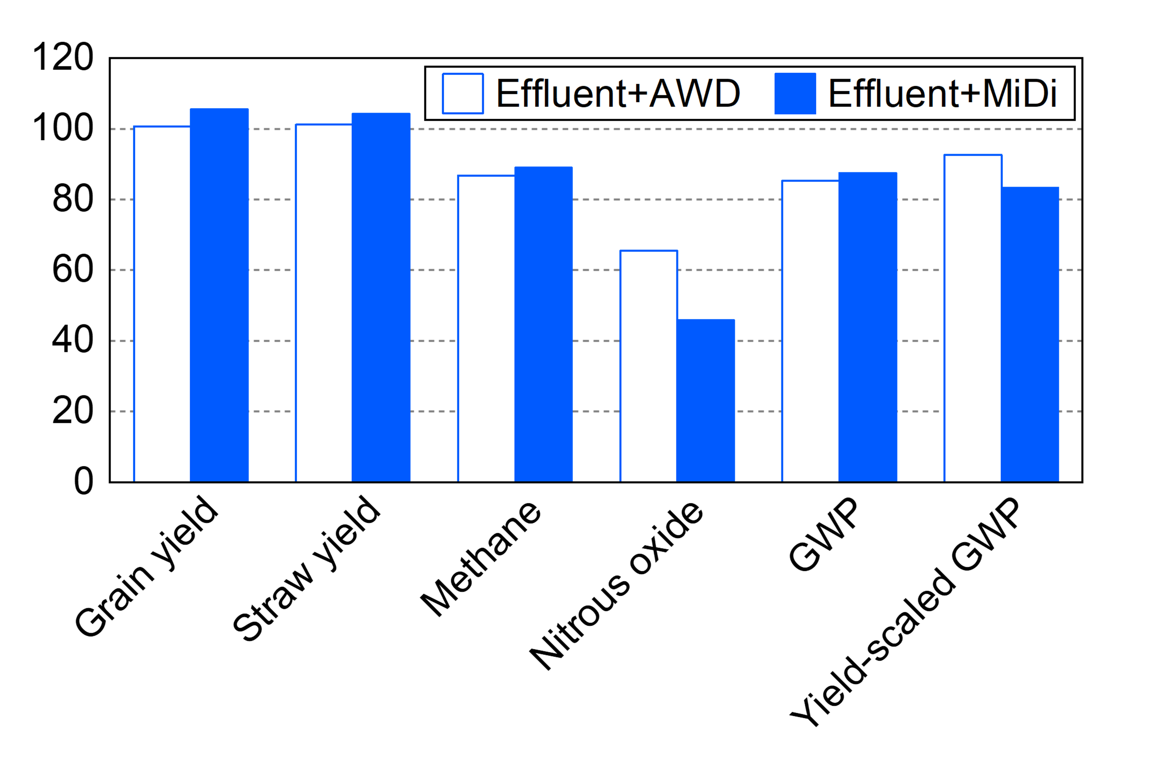
対象とする食料サプライチェーンの段階に合わせて、(a)～(d)の１つをセットで使用
上余白10mm確保
英文フォントは「Segoe UI」を使用
Agriculture, Forestry and Fisheries Technology Catalog for the Asia-Monsoon region
(a)
Procurement
----------
Methane emission reduction technology by the combination of biogas effluent application and multiple drainage in a rice paddy
タイトル領域4cm
(b)
Production
-----
タイトルのフォントは18pt太字
英文タイトルは下揃えで3行以内
(c)
Processing and
distribution
-------------
Production
Demonstration
Item: Paddy rice
GHG emission reduction
左右余白は15mm確保
（冊子版綴じ代）
(d)
Consumption
----------
Outline
The technology which combing biogas effluent application and multiple drainage could reduce methane (CH₄) emission from rice paddy fields without yield loss, as compared to the local conventional practice.
本文のフォントは11p
行間は1.2倍で固定
字間は標準
両端揃え
Background/effect/note
The technology which combines cattle biogas effluent as fertilizer and multiple drainage could reduce 1) greenhouse gas emission from rice paddy fields and 2) environmental problem caused by the discharge of untreated biogas effluent into rivers. In the triple-rice cropping system in Mekong Delta in Vietnam, the technology with each of two multiple drainage practices, AWD*, a water-depth-dependent irrigation, and MiDi, a day-number-dependent irrigation (Fig.1) reduced CH₄ emission by 11-13% and nitrous oxide (N₂O) emission by 35-54% without yield loss (Fig.2).
The proposed technology can be applied to the rice-producing areas using livestock biogas effluent as fertilizer.
左右余白は15mm確保
（冊子版綴じ代）
本文のフォントは11p 「Segoe UI」を使用
行間は1.2倍で固定
字間は標準
両端揃え
英語版では、段落の間は行間を空ける。段落後3pt。
*AWD (alternate wetting and drying) and MiDi (Midseason drainage followed by intermittent irrigation) are water management practices with a combined effect of water-saving by repeatedly flooding and draining water in paddy fields, and reduction of CH4 emission by increasing the oxygen concentration in the soil.
専門用語を使う必要があれば、近傍に注釈を入れる。
Conventional
Proposed
Ratio to conventional practice (％）
Biogas digester
図表キャプション
10p、行間は1倍で固定
両端揃え
Fig.2. Comparison between the proposed combination technology and conventional practice.
GWP: CO₂-equivalent of combined CH₄ and N₂O emissions
Fig.1. The technology proposed to reduce CH₄ emission from rice paddy fields without yield loss.
詳細情報
URLとQRコードを併記。
QRコードは次で生成可。
https://m.qrqrq.com/
位置は図表に合わせて左右どちらに寄せても良い。
Technical details:
https://www.jircas.go.jp/ja/publication/research_results/2021_a01
Japan International Research
Center for Agricultural Sciences
下余白は15mm確保
（ページ番号挿入予定）

